Slide 1

Fun way to E-Shop
C-Shopping
Bhuvaneshwari R
Sapna J

Slide 2





Overview
What? Why?
Demo
How does it work?
Business Needs
Future

Slide 3
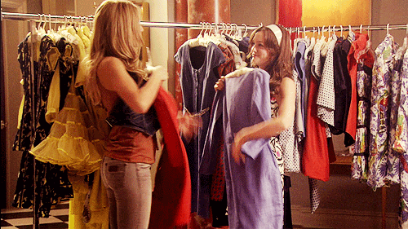
”Shopping” the very reminds us of going out with friends/family

Slide 4

Online Shopping - Solo Experience
No friends to help into making the ‘this or that’ decision

Slide 5
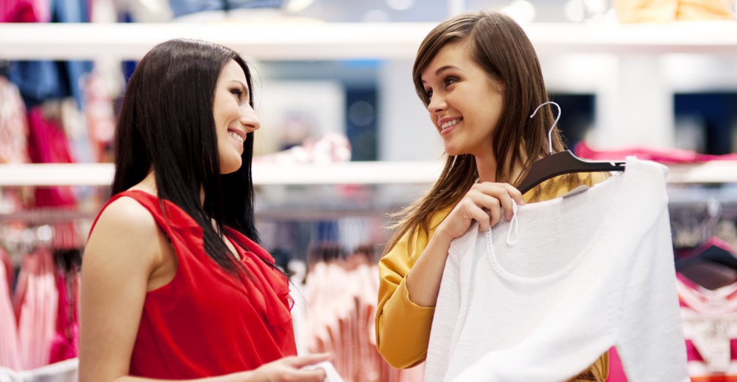

Friends and Family - influential resources for making buying decisions
If it is not social, it is not Shopping!

Slide 6

Replicate the social experience by creating collaborative, accessible shopping environments.

Slide 7
What e-shoppers want?
The ability to privately invite people they trust to "shop with them online;”
To be able to shop side-by-side as if they were together looking at the same products at the same time, but with the freedom to "roam the store" separately;
To be able to collaborate in real time and also asynchronously

Slide 8
C-Shopping

Slide 9
C-Shopping
Real-time social web shopping
a Convenient and Collaborative Shopping env
Brings Social Conversations for your online store
Decide and buy
Mix & Match - Collaborative New Look Creation

Slide 10





Key Features
Works on all sizes
easy-to-use
Group Messaging, Audio & Video Chat

Slide 11



Key Features
Search and Send Request to Connect
Share Your current position on Screen
drag and drop products you like and want to share

Slide 12
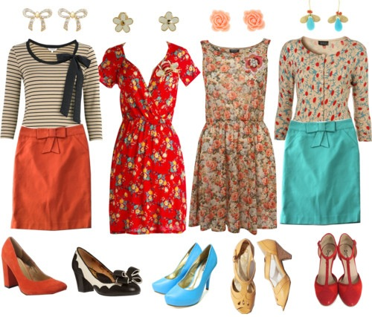
Collaborative creating of fashionable lookbooks

Slide 13

Plug & Play
Can be Easily integrated into any e-commerce Solution Provider.

Slide 14
DEMO

Slide 15
ENGINE BEHIND

Slide 16
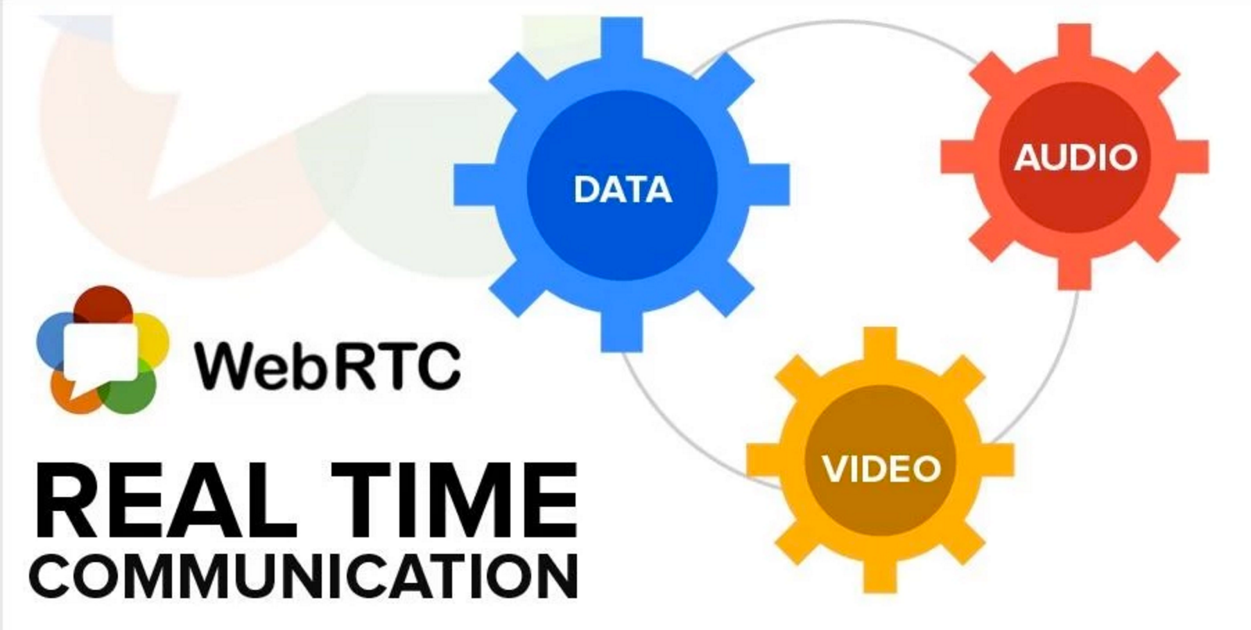



Behind the scenes

Slide 17

What Retailers Get

Slide 18
Key Business Advantages
Promote
Engage
Convert

Slide 19
Buying Sentiments
of people trust recommendations from friends and family, over all other forms of marketing
92%
of consumers are more likely to buy a new product when learning about it from friends or family.
77%

Slide 20

Time Taken to complete the purchase
> 15hrs
35%
> 3 days
22%

Slide 21


LookBook Creation
94%
Websites with Images get 94% more total view & attracts customer of every age.

Slide 22
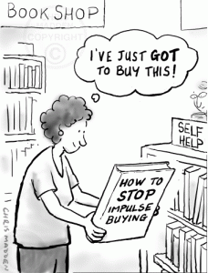
I have to have it!
Impulse buys can be generated

Slide 23

Different & Distinctive
A distinctive selling point by offering customers shopping functions they cannot use in other online shops.

Slide 24






Every major retail vertical market segment can benefit from collaboration.

Slide 25
WHAT CAN YOU EXPECT IN THE FUTURE!

Slide 26
Future Extensions
Offer a ‘thank you’ incentive to friends for helping
Recommend Products to friends
Prioritize Product Reviews based on friend list
Share Cart
Offers on Newlooks
Sentiment Analysis

Slide 27

e-commerce is a business, e-shopping is an Emotion.

